Slide 1

First Step in PHP
By Ali Khorsandfard

Slide 2

Basics:
Is it worth to learn it?
What is PHP:

Slide 3
Learn php? Worth it?
Wide usage: PHP is one of the most popular programming languages for web development, and it is used on millions of websites and web applications worldwide. Many big websites such as Facebook, Wikipedia, and WordPress are built with PHP.
Easy to learn: PHP is a relatively easy language to learn, especially if you already have some programming experience. The syntax is straightforward, and there are plenty of resources available online to help you get started.
Server-side scripting: PHP is a server-side scripting language, meaning that the code is executed on the server before being sent to the client's browser. This makes it more secure compared to client-side scripting languages such as JavaScript.
Good job prospects: As PHP is still widely used for web development, there are plenty of job opportunities available for developers who are proficient in PHP.
Overall, if you're interested in web development, learning PHP can be an excellent skill to have in your arsenal, and it can open up many job opportunities for you.

Slide 4
What is PHP?
PHP stands for Hypertext Preprocessor, and it is a server-side scripting language used primarily for web development. It is an open-source language that is widely used for creating dynamic web pages and web applications. It run on the server.
PHP can generate HTML and almost any type of file like PDF, excel , …
PHP can manage Server! (you can run any server command programmatically)
PHP can generate and send Email, and print documents. Anything your linux server can do, PHP can manage it!
PHP can run on all server! Linux, windows, UNIX , Mac Server.
PHP is Easy to start but deep enough to take years from you!
PHP is free!
There is tons of ready-made classes!
PHP can AI as well!

Slide 5
Setup Enviroment
Install Xampp
https://www.apachefriends.org/download.html
Install Visual Studio Code
https://code.visualstudio.com/download
Install php code extension on vs code

Slide 6










What is Web Server
Mywebsite.com
IP:213.16.34.45
IP: 248.19.151.78
IP: 75.198.65.25
IP: 64.35.17.19

Slide 7



What is Web Server
Mywebsite.com
IP:213.16.34.45
IP: 248.19.151.78
Mywebsite.de
IP: 75.198.65.25
www.mywebsite.com
Mywebsite.com
DNS SERVER
IP:213.16.34.45
IP:4.2.2.4
IP: 64.35.17.19

Slide 8
What is Web Server
Mywebsite.com
IP:213.16.34.45
IP: 248.19.151.78
IP: 75.198.65.25
www.mywebsite.com
213.16.34.45
Mywebsite.com
DNS SERVER
IP:213.16.34.45
IP:4.2.2.4
IP: 64.35.17.19
Mywebsite.de

Slide 9
What is Web Server
Mywebsite.com
IP:213.16.34.45
IP: 248.19.151.78
213.16.34.45
IP: 75.198.65.25
www.mywebsite.com
Mywebsite.com
DNS SERVER
IP:213.16.34.45
IP:4.2.2.4
IP: 64.35.17.19
Mywebsite.de

Slide 10
What is Web Server
Mywebsite.com
IP:213.16.34.45
IP: 248.19.151.78
IP: 75.198.65.25
www.mywebsite.com
Mywebsite.com
DNS SERVER
IP:213.16.34.45
IP:4.2.2.4
213.16.34.45:80
IP: 64.35.17.19
Mywebsite.de

Slide 11

What is Web Server
Webserver Software
IP: 75.198.65.25
Request 213.16.34.45:80
From 75.198.65.25:1895
IP:213.16.34.45
OK, Request is on port 80!
I shall give it to webserver and wait
For answer and send answer back to
requestor
Server host
Mywebsite.com
Apache , Nginx, IIS …

Slide 12
What is Web Server
Webserver Software
IP: 75.198.65.25
Request 213.16.34.45:80
From 75.198.65.25:1895
htdoc folder
Mywebsite.com
folder
IP:213.16.34.45
Index.html

Slide 13

Webserver in case of php
Webserver Software
IP: 75.198.65.25
Request 213.16.34.45:80
From 75.198.65.25:1895
htdoc folder
Mywebsite.com
folder
IP:213.16.34.45
Php Engine
Index.php

Slide 14
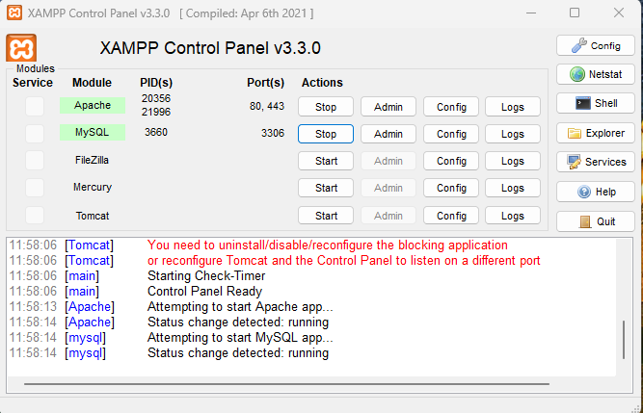
Setup Enviroment
Install Xampp
https://www.apachefriends.org/download.html
Install Visual Studio Code
https://code.visualstudio.com/download
Install php code extension on vs code
Run Xampp and start Apache and MySQL by click on start

Slide 15
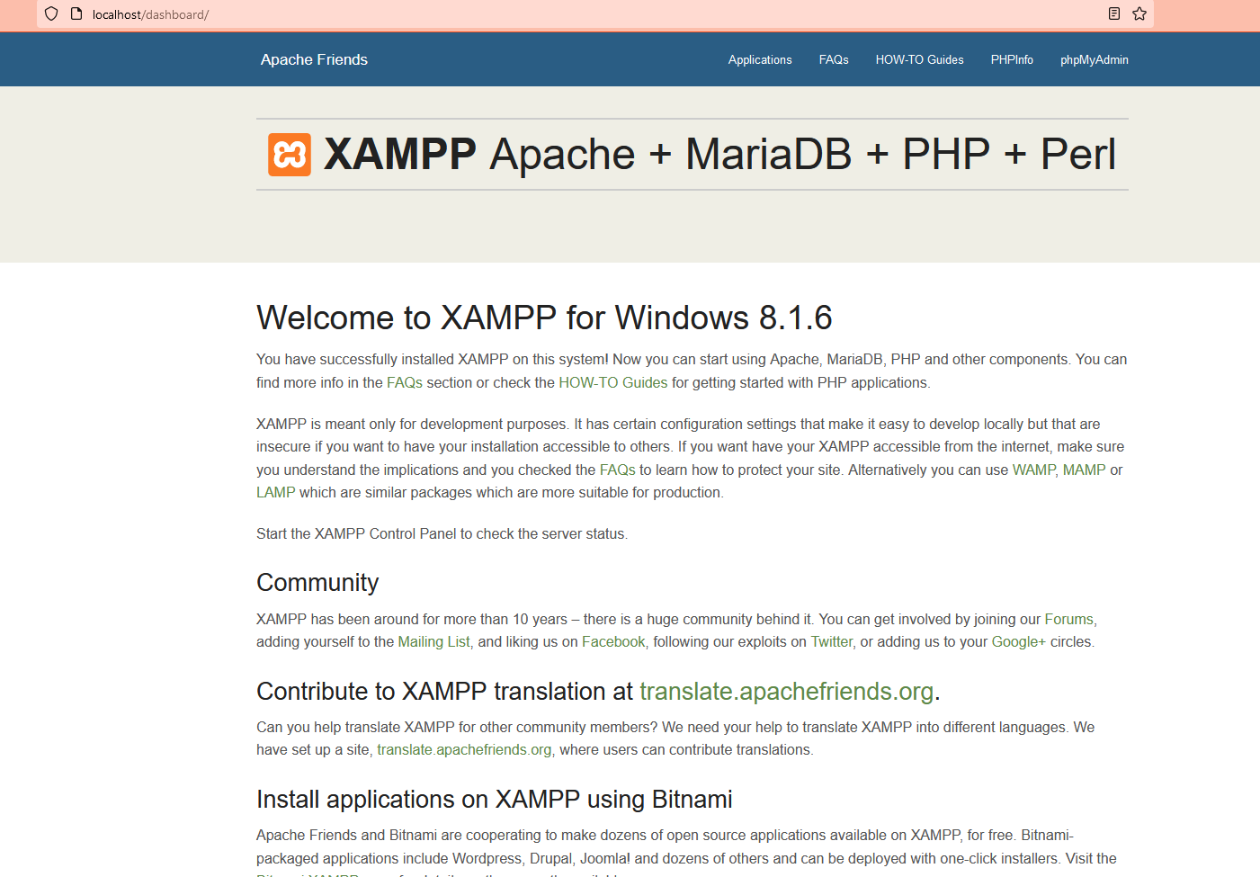
Test Apache
Click on Admin and you shall see your browser open localhost address with almost same content . It means you successfully installed Apache

Slide 16
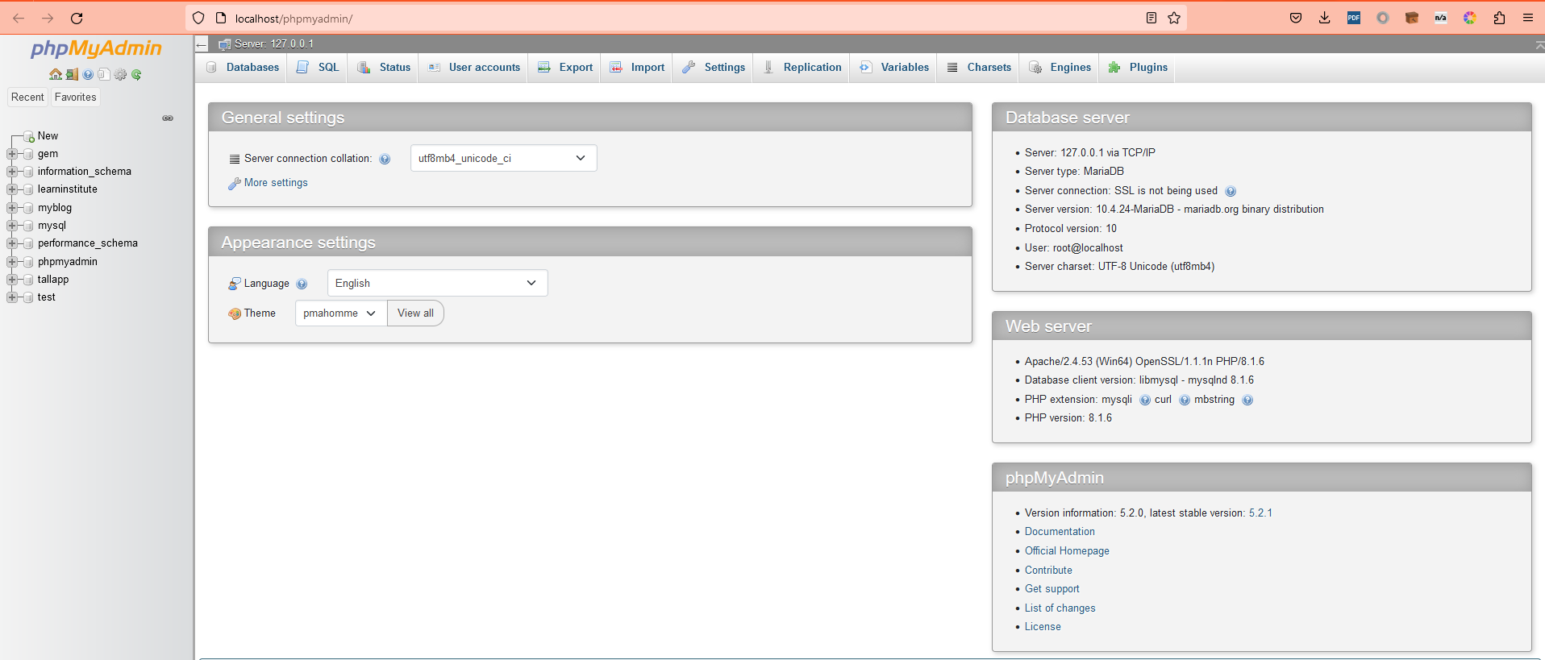
Test MariaDB
Click on Mysql -> Admin and you shall see your browser open localhost address with almost same content . It means you successfully installed Mysql

Slide 17
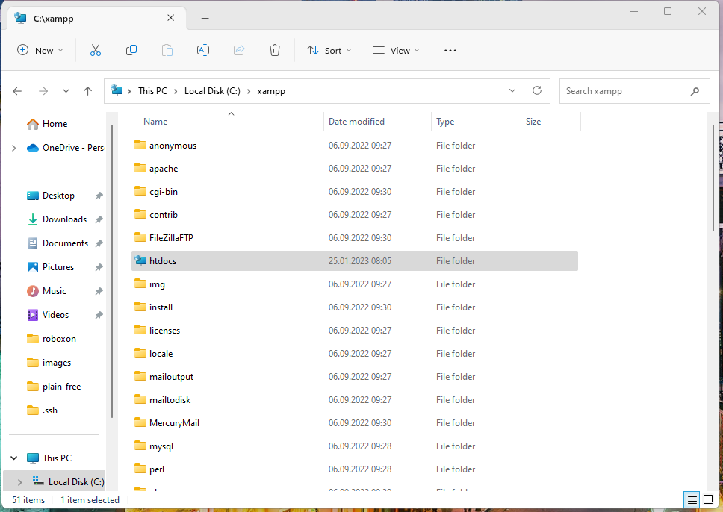
Open htdocs
Click on Explorer and you can see a folder is opened! This is place that your code can be saved and run by Apache! Folder is htdocs!
Remember the top path. C:/xampp/htdocs

Slide 18
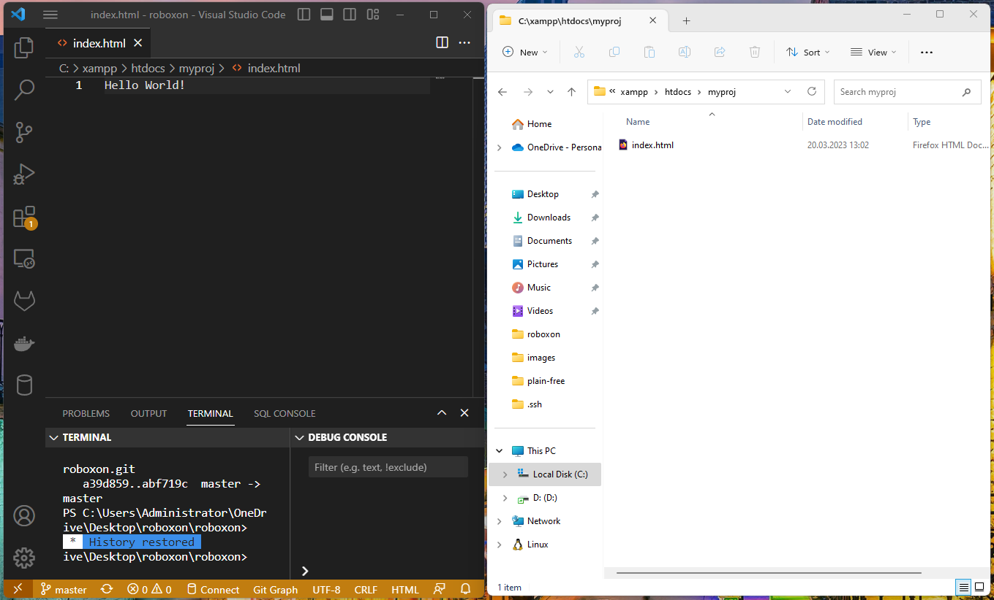
Create Project
Go inside htdocs and create new folder myproj and go inside it.
Create index.html file
Open this file with your vs code and write inside simply following text:
Hello World!
Save the file

Slide 19
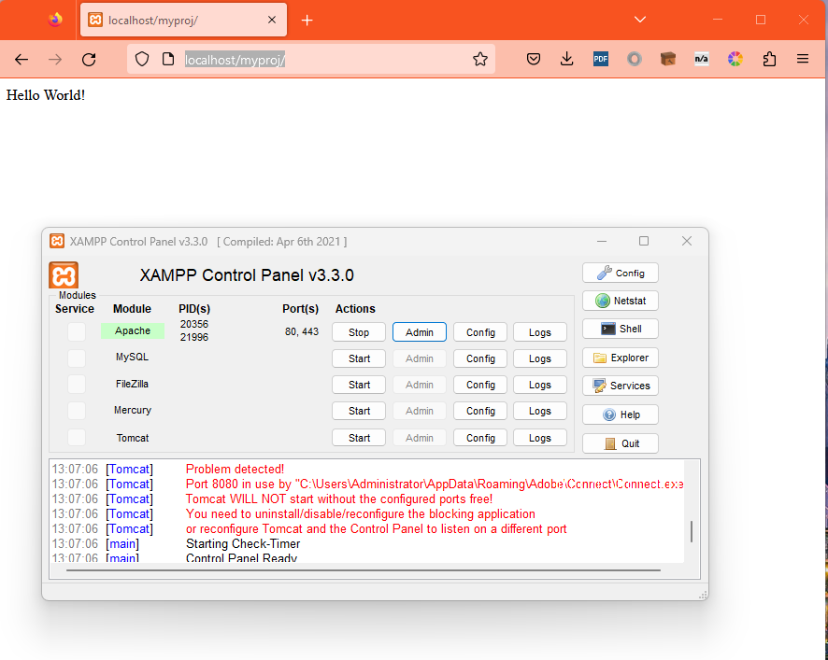
Run it!
Run Xampp and click on Admin button front of Apache
On the opened Browser address type your project folder name after localhost as follows:
http://localhost/myproj/
You shall see Hello World!
Step 2
Step 1
Note: the name of folder you Entered
shall be same here

